Slide 1
RTS: Threat led penetration tests
PUBLIC INTRODUCTORY INFORMATION MEETING
Tomáš Sýkora
19.6.2025

Slide 2
Current state of the RTS
ECB-Public
RTS has been published in the Official Journal of the European Union as of 18.6.2025
Therefore it enters into force as of 8.7.2025
Link to official publication of RTS on TLPT:
https://eur-lex.europa.eu/legal-content/EN/TXT/PDF/?uri=OJ:L_202501190

Slide 3
Quantitative criteria
ECB-Public
Qualitative criteria
Credit institutions identified as global systemically important institutions (G-SIIs) or as other systemically important institutions (O-SIIs) or that are part of a G-SIIs or O-SIIs.
Payment institutions, exceeding EUR 150 billion of payment transactions (2 years)
Electronic money institutions, exceeding EUR 150 billion of payment transactions (2 years)
Central securities depositories
Central counterparties
Trading venue with the highest market share
Insurance and reinsurance undertakings with gross written premium (GWP) exceeding EUR 1 500 000 000
Impact-related and systemic character related factors:
  size of the financial entity
  extent and nature of the interconnectedness of the financial entity
  the criticality or importance of the services provided to the financial sector
  the substitutability of the services provided by the financial entity
  the complexity of the business model of the financial entity and the related services and processes
  whether the financial entity is part of a group of systemic character at Union or national level
ICT risk related factors

Slide 4
TLPT Authority in Slovak Republic
ECB-Public
TLPTA is public authority in the financial sector to be responsible for TLPT-related matters in the financial sector at national level
TLPTA in Slovak Republic is NBS
  For the purposes of mutual recognition under the DORA, Národná banka Slovenska shall issue attestation of performance a TLPT test.
For significant credit institutions (SSM) TLPTA is ECB
  Competent authority may delegate the exercise of some or all of the tasks referred to another national authority in the financial sector.

Slide 5
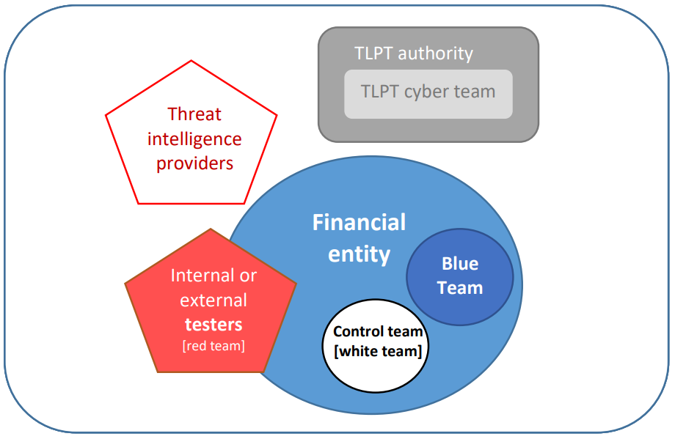
TLPT Participants
ECB-Public

Slide 6

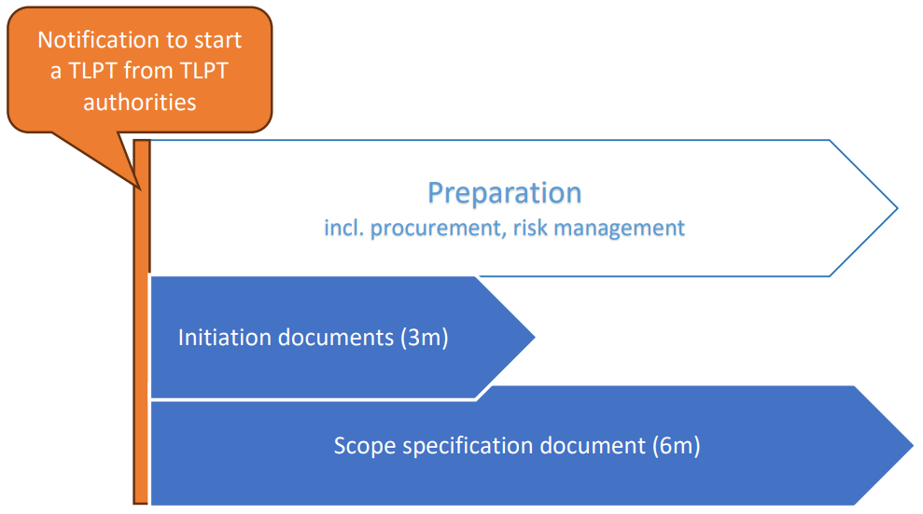
TLPT Phases
ECB-Public
Preparation

Slide 7
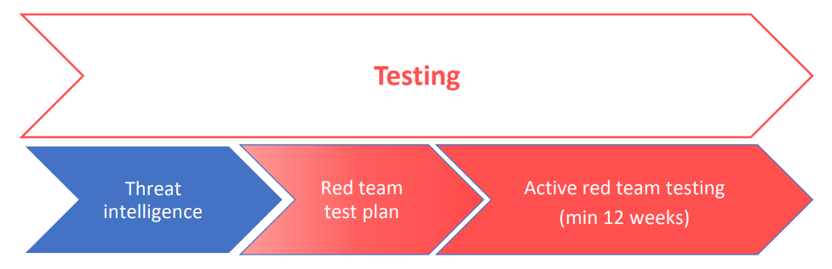
TLPT Phases
ECB-Public

Slide 8
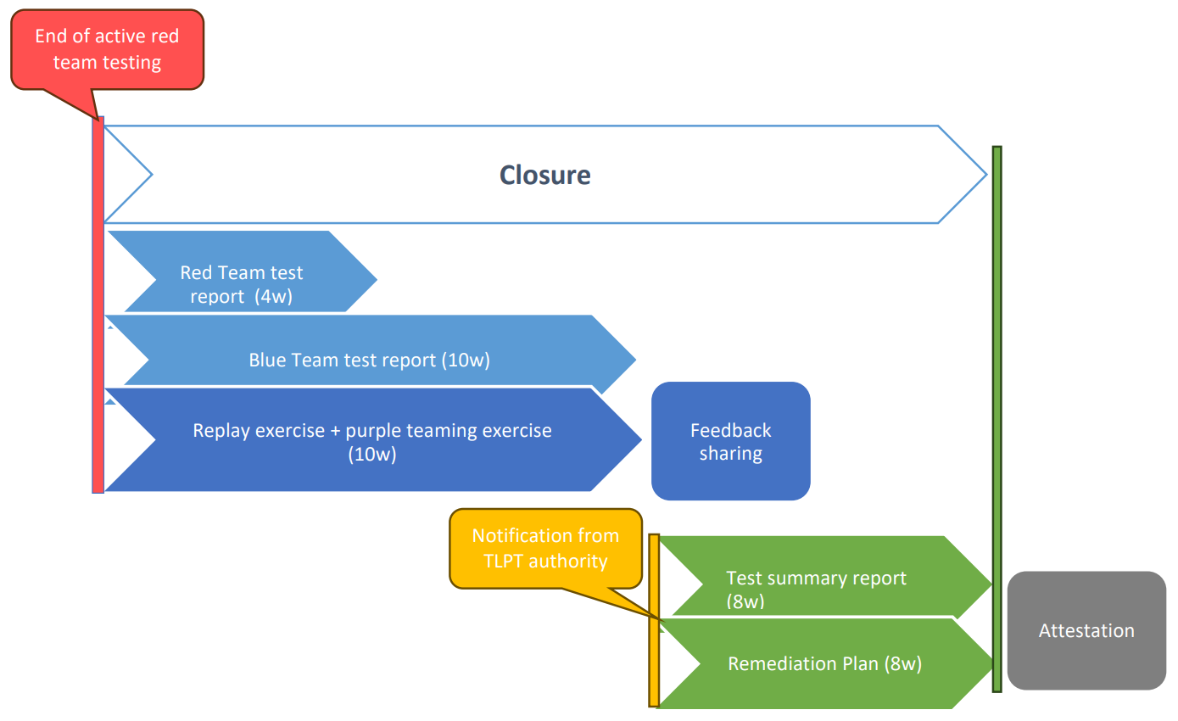
TLPT Phases
ECB-Public

Slide 9
The TIBER-EU framework aims to harmonize and standardize the approach to threat intelligence-based ethical red-teaming across Europe.
TIBER-EU framework can also assist competent authorities and financial entities in meeting the requirements for threat-led penetration tests under the Digital Operational Resilience Act (DORA).
Mutual recognition of TIBER-XX and DORA TLPT (only if the same group is using common ICT systems)
International TLPT
ECB-Public
TIBER-EU
Joint TLPTs. Another case for cooperation between TLPT authorities is when TLPT authorities decide to organise joint TLPTs on several financial entities established in different Member States but using the same ICT intra-group service provider, or belonging to the same group and using common ICT systems.
Pooled TLPTs. In this case the TLPT authorities shall designate which financial entity shall be the designated financial entity according to Article 26(4) DORA and which financial entities only participate in the pool and once again the TLPT authorities of the pariticipating financial entities shall agree amongst themselves as to who shall lead the TLPT.

Slide 10
CTLPT Q&A?
Open discussion about future inter-department cooperation.

Slide 11
Thank you for your attention!
NBS je aj:
Múzeum mincí a medailí v Kremnici
5peňazí
Nadácia NBS
Inštitút bankového vzdelávania

