Slide 1
Požiadavky podľa RTS, TIBER a praktické aspekty TLPT
TLPT Providers Workshop
Ing. Richard Kellner
19.06.2025 Kongresová sála NBS

Slide 2

TIBER-SK specifics
Upon mutual agreement with TM, the FE can expand the scope of the test beyond the CIFs and include other functions, processes and third parties.
Physical red teaming is allowed in TIBER-SK for the TLPT test (e.g. planting a device at the entity), provided all necessary precautions are taken.
Generic Threat Landscape Report (GTL Report) for the Slovak financial sector is NOT guaranteed to be produced.

Slide 3
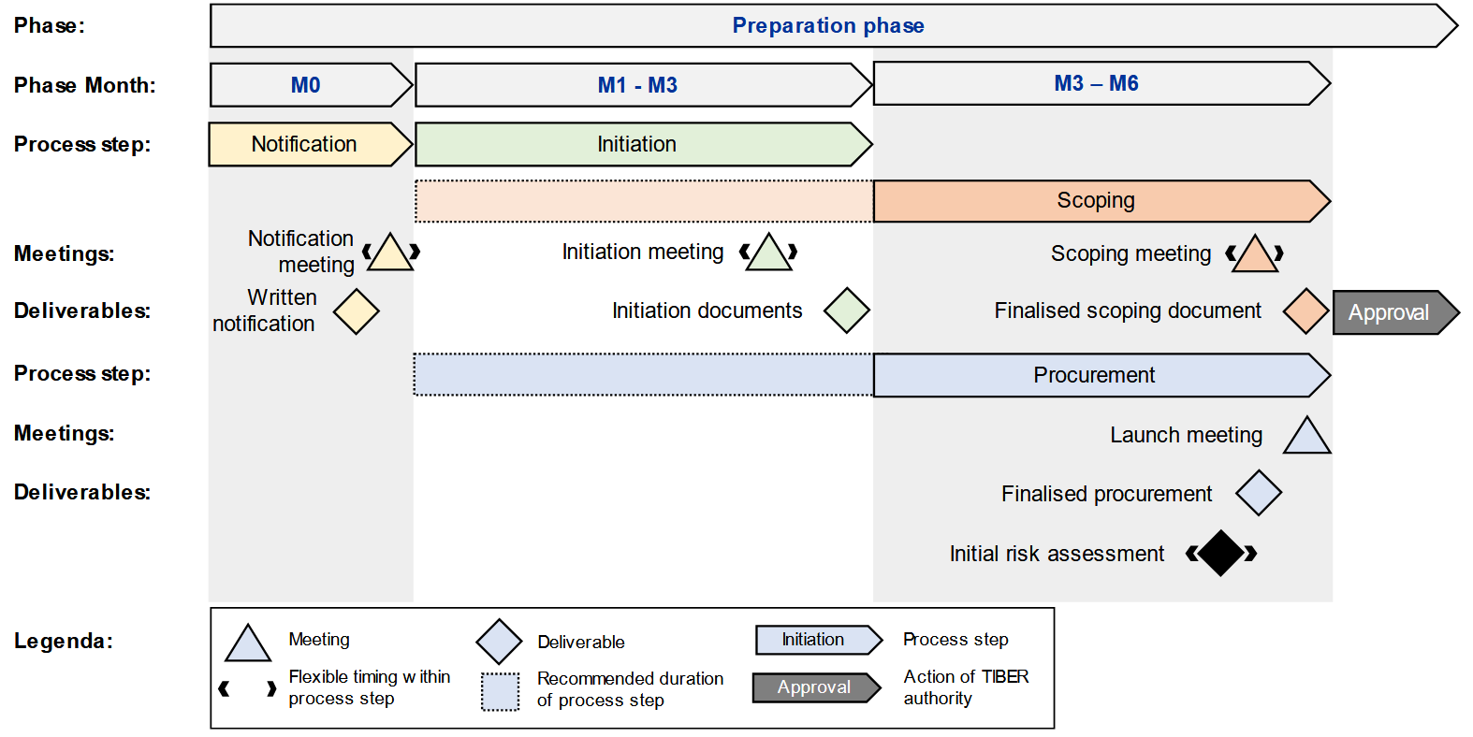
Preparation phase

Slide 4

Procurement
The size of the teams will depend on the entity being tested, the scope of the test, and the specific skills and expertise required to deliver the test.
Small provider teams are at risk of falling short of resourcing, e.g. during holiday periods, leave or other absence. Therefore, the entity should pay attention to personnel turnover when selecting a provider.
Any changes in the composition of the TIP or RTT must be communicated and agreed by the CTL and TM.
Three of the most important criteria for a buyer of threat intelligence or red team services are:
the reputation
history of the provider
the ethical conduct it both adopts and enforces.

Slide 5
Procurement
During any TIBER-EU test, it is likely that the TIP/RTT will encounter sensitive or business-critical data related to the entity or its third-party suppliers.
Overall, the entity will need to be comfortable that it can trust the TIP/RTT.
The entity should request the provider to furnish evidence of its relevant internal information security policies that ensure the security and resilience of its services and methods.
Language in which TLPT will be held is up to a mutual agreement between the all parties: EN and SK or CZ.
Highly recommended to rotate service providers for every test
A service provider that is currently or has previously provided ICT-services, could be in conflict of interest.
Both the entity and the service provider have to demonstrate that the conflict of interest has ceased.
TM does not give market advice to FE. However, the TM may give ad hoc guidance to the CT, depending on the specificities of the test.

Slide 6
DORA/RTS – Provider Criteria (TI Provider)
Who | Requirements
Company as a whole | Appropriate certifications according to recognized market standards duly and fully covered by relevant professional indemnity insurances, including against risks of misconduct and negligence three references from previous assignments in the context of penetration testing and red team testing Provide evidence of fulfilment of criteria to CT
Team as a whole | At least one manager + one member broad range and appropriate level of professional knowledge and skills (intelligence gathering, geopolitical, technical, sectorial, communication, presentation, reporting) combined participation in at least three previous TI assignments in PT/ RT
Each team member | five (manager) / two (team member) years of experience in threat intelligence not simultaneously performing any task posing a potential conflict of interest (e.g. BT duties) be separated from TI Provider for the same TLPT Provide detailed CV to CT

Slide 7
DORA/RTS – Provider Criteria (Testers)
Who | Requirements
Company as a whole | Appropriate certifications according to recognized market standards duly and fully covered by relevant professional indemnity insurances, including against risks of misconduct and negligence five references from previous assignments in the context of penetration testing and red team testing Provide evidence of fulfilment of criteria to CT
Team as a whole | At least one manager + two members broad range and appropriate level of professional knowledge and skills (entity business, reconnaissance, risk management, exploit development, physical penetration, social engineering, vulnerability analysis, communication, presentation, reporting) combined participation in at least five previous TI assignments in PT/ RT
Each team member | five (manager) / two (team member) years of experience in threat intelligence not simultaneously performing any task posing a potential conflict of interest (e.g. BT duties) be separated from external testers for the same TLPT Provide detailed CV to CT

Slide 8
The exception that proves the rule
The exemption clause
Article 7(2)
In exceptional circumstances, financial entities may contract external testers and threat intelligence providers that do not meet one or more of the requirements set out in […], provided that those financial entities adopt measures that are appropriate to mitigate the risks relating to the lack of compliance with such points and record those measures.
The veto clause
Article 9(11)
Prior to contracting the selected threat intelligence providers and external testers, the control team shall provide to the test managers evidence of compliance of those threat intelligence providers and testers with the requirements laid down in […]. The control team shall not proceed with contracting the selected threat intelligence providers and external testers where the TLPT authority is of the opinion that the selected threat intelligence providers and external testers do not comply with the requirements[…]

Slide 9
DORA/RTS – Provider Criteria (Internal Testers)
TI Provider always has to be external
Only if financial entity is not an SSM institution
External testers have to be used at least every three tests
Approval of the relevant TLPTA required
Testers employed by an ICT intra-group service provider shall be considered as internal testers of the financial entity.
establishment and implementation of a policy for the management of internal testers in a TLPT
measures to ensure that the use of internal testers to perform a TLPT does not negatively impact the financial entity’s general defensive or resilience capabilities
measures to ensure that internal testers have sufficient resources and capabilities to perform a TLPT
… and others

Slide 10
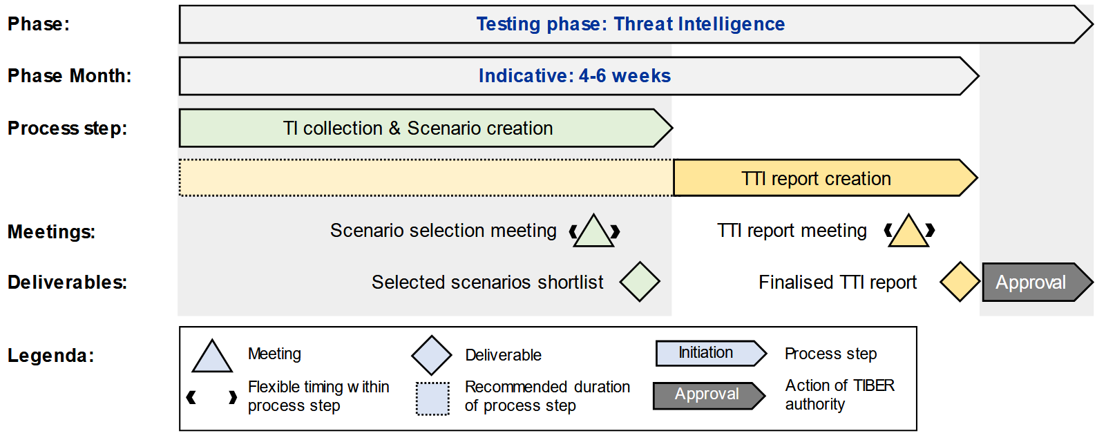
Threat Intelligence phase

Slide 11
Targeted Threat Intelligence Report
Overall scope of the intelligence research including at least the following:
critical or important functions (CIF) in scope;
their geographical location;
official EU language in use;
relevant ICT third party services providers;
the period of time over which the research is gathered.
Assessment of what concrete actionable intelligence can be found about the financial entity, such as:
employee usernames and passwords;
look-alike domains which can be mistaken for official domains of the financial entity;
technical reconnaissance: vulnerable and/or exploitable software, systems and technologies;
information posted by employees on social media, related to the financial entity, which might be used for the purposes of an attack;
information for sale on the dark web;
any other relevant information available on the internet or public networks;
where relevant, physical targeting information, including ways of access to the premises of the financial entity

Slide 12
Targeted Threat Intelligence Report
Threat intelligence analysis considering the general threat landscape and the particular situation of the financial entity, including, at least:
geopolitical environment;
economic environment;
technological trends and any other trends related to the activities in the financial services sector.
Threat profiles of the malicious actors (specific individual/group or generic class) that may target the financial entity, including the systems of the financial entity that malicious actors are most likely to compromise or target, the possible motivation, intent and rationale for the potential targeting and the possible modus operandi of the attackers.
Threat scenarios: at least three end-to-end threat scenarios for the threat profiles identified who exhibit the highest threat severity scores. The threat scenarios shall describe the end-to-end attack path.

Slide 13
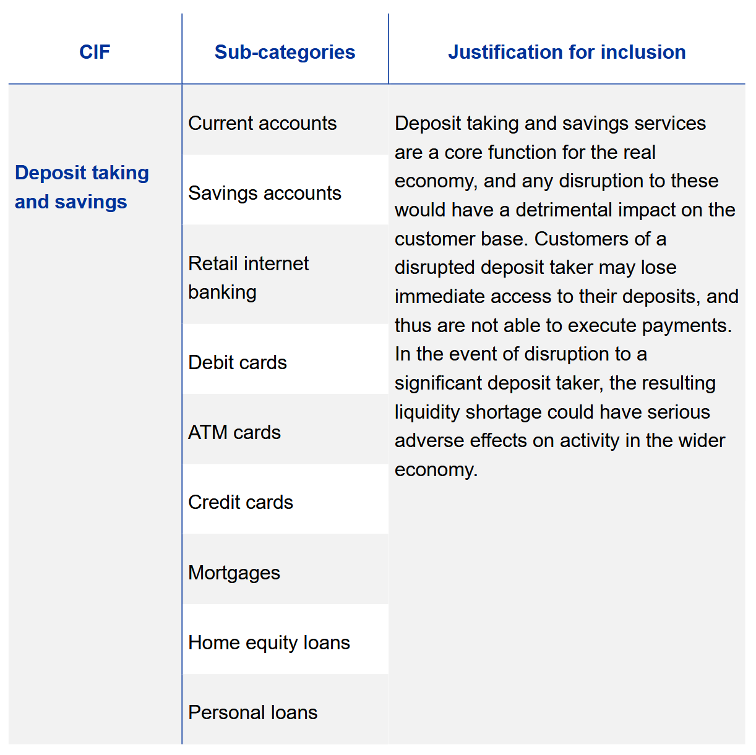
Contextualise critical or important functions

Slide 14
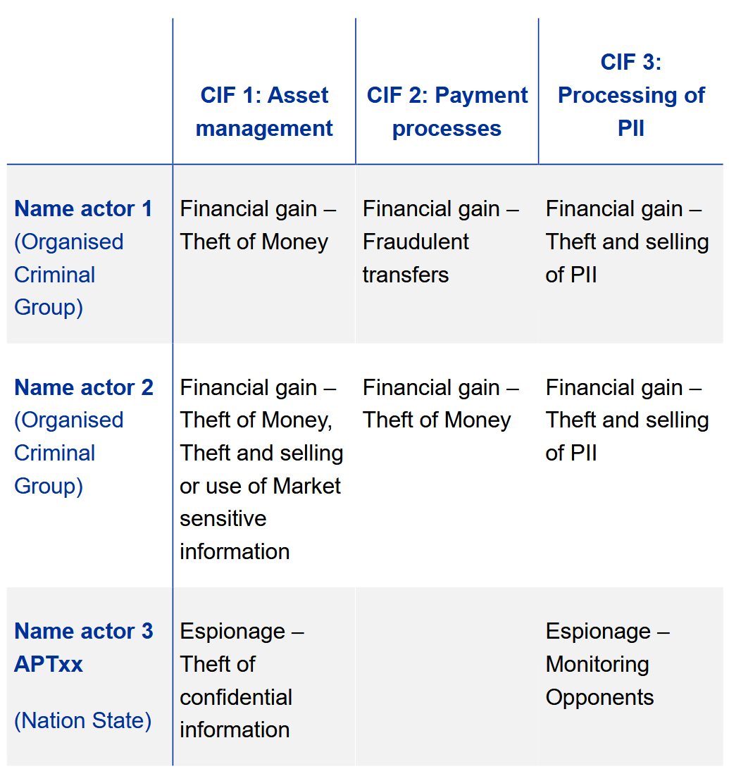
Identify threat actors, understand capability and intent

Slide 15
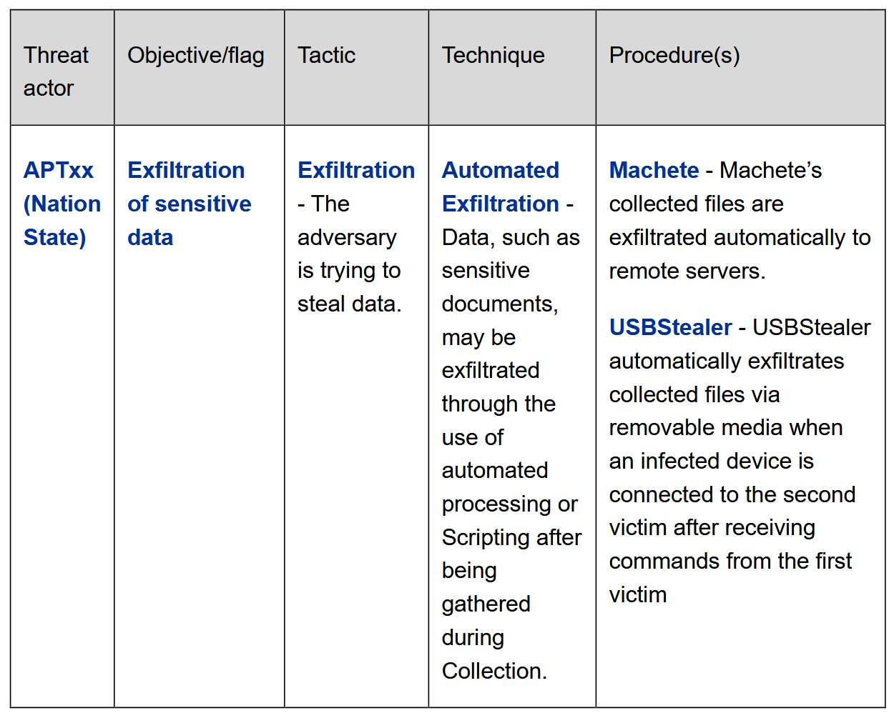
Determine modus operandi

Slide 16
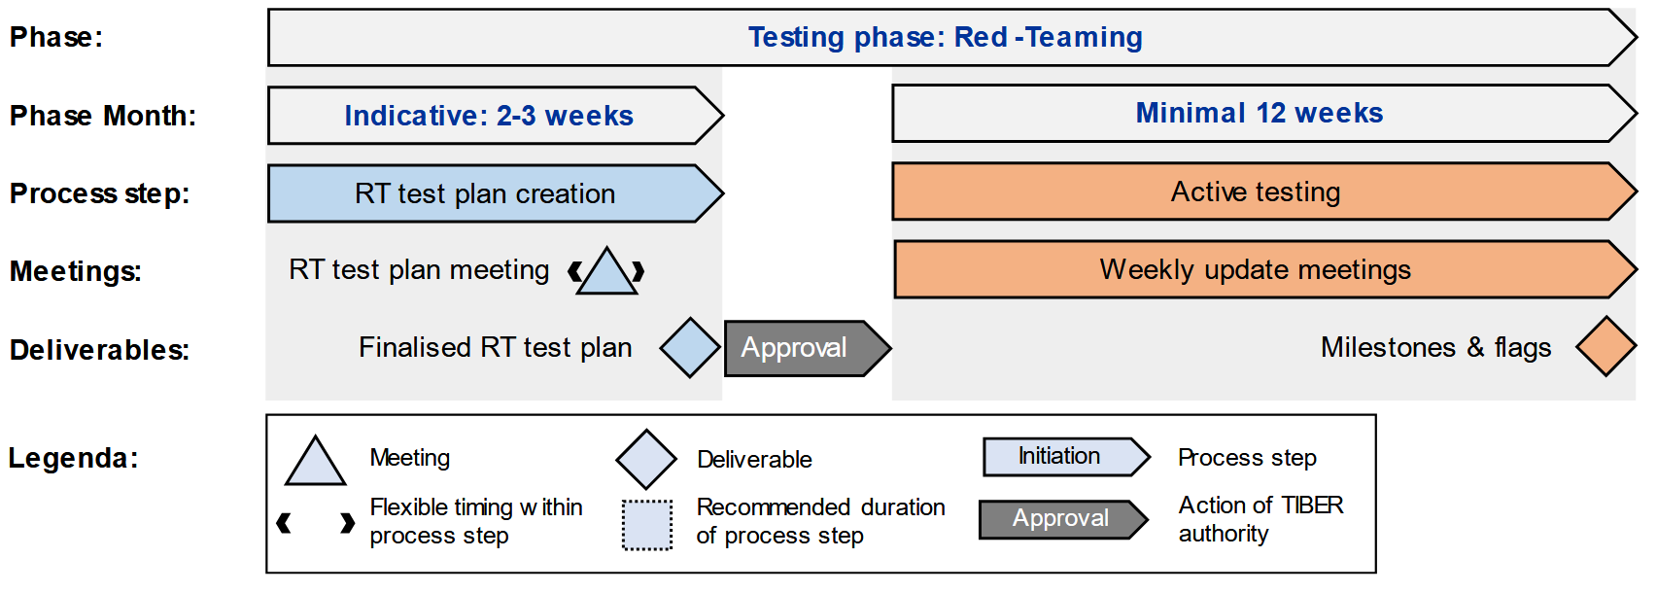
Red Teaming

Slide 17
Red Team Test Plan
Critical or important functions (CIF), the supporting ICT systems and flags: The relevance of the critical or important function being tested, and how the flag/objective relates to the critical or important function and its underlying systems and services.
Simulated threat actor, their motive, intent and goals: how they would seek to target the specified CIFs; which of the CIA triad (Confidentiality, Integrity, Availability) they would seek to compromise; and how they would focus their efforts on achieving the final flags.
Tactics, techniques and procedures (TTP): What tactics, techniques and procedures the threat actor would use to achieve the specific flags. These TTPs should be set out in line with the MITRE ATT&CK Framework.
Leg-ups: The potential leg-ups that will be required in case the RTT are unable to achieve the flag/objective within its specified timeline.
Risk management controls: The risk management controls that the RTT will have in place to manage any risk stemming from implementing the attack scenario.
Scenario X: in addition to these scenarios, an RTT may develop other types of scenarios. RTT could deploy creative and innovative TTPs. The RTT can leverage forward-looking scenarios based on TTPs that have not yet been seen but are expected in the future.

Slide 18
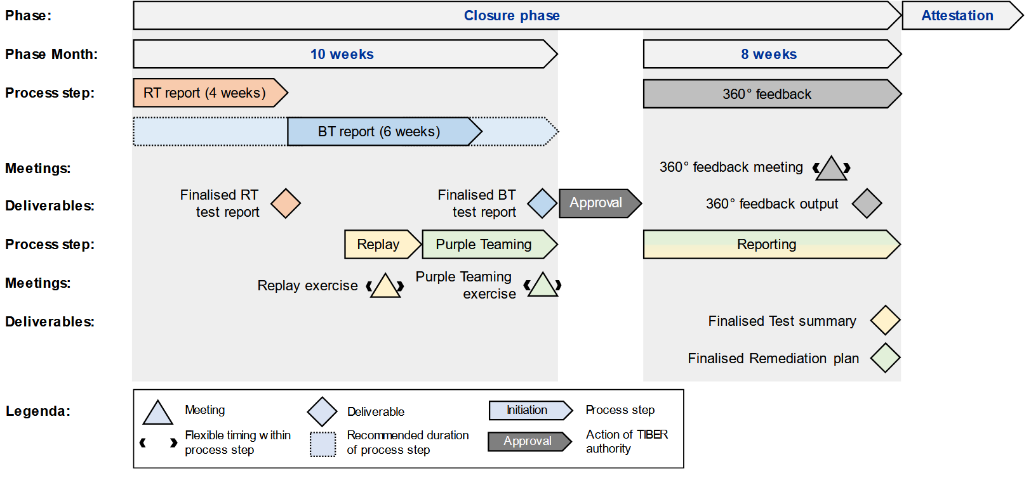
Closure phase

Slide 19
Red Team Test Report
Information on the performed attack, including:
the targeted critical or important functions (CIF) and identified ICT systems, processes and technologies supporting the CIF, as identified in the Red Team Test Plan (RTTP);
a summary of each scenario;
flags reached and not reached;
attack paths followed successfully and unsuccessfully;
tactics, techniques and procedures (TTP) used successfully and unsuccessfully;
deviations from the RTTP, if any;
leg-ups granted, if any;
All actions that the testers are aware of that were performed by the BT to reconstruct the attack and to mitigate its effects;
Discovered vulnerabilities and other findings, including:
vulnerability and other finding description including their criticality;
root cause analysis of successful attacks;
recommendations for remediation including indication of the remediation priority.

Slide 20
Replay, Purple Teaming exercise and 360 feedback
Replay exercise:
the progression through attack stages of each scenario and relevant learning generated;
what else could have been achieved by the RTT with more time and resources;
potential remediation measures;
general questions from the BT.
Purple Teaming excercise:
relevant issues that could not be tested during the active testing phase particular vulnerabilities identified during the test;
other steps which could have been taken by the RTT and potential BT responses;
alternative scenarios and their potential consequences;
proof of concepts;
discussion of anticipated remediation measures with the RTT;
business continuity exercises.

Slide 21
NBS je aj:
Múzeum mincí a medailí v Kremnici
5peňazí
Nadácia NBS
Inštitút bankového vzdelávania

