Slide 1

enter e-Estonia
© Renee Altrov
ERIKA PIIRMETS
Digital Transformation Adviser
e-Estonia Briefing Centre
safest digital identity

Slide 2

advantages
a secret key to all online services
first card issued in 2002
mandatory ID
99% of the population has an ID-card
5 days and 2% of GDP per year is saved using digital signature

Slide 3
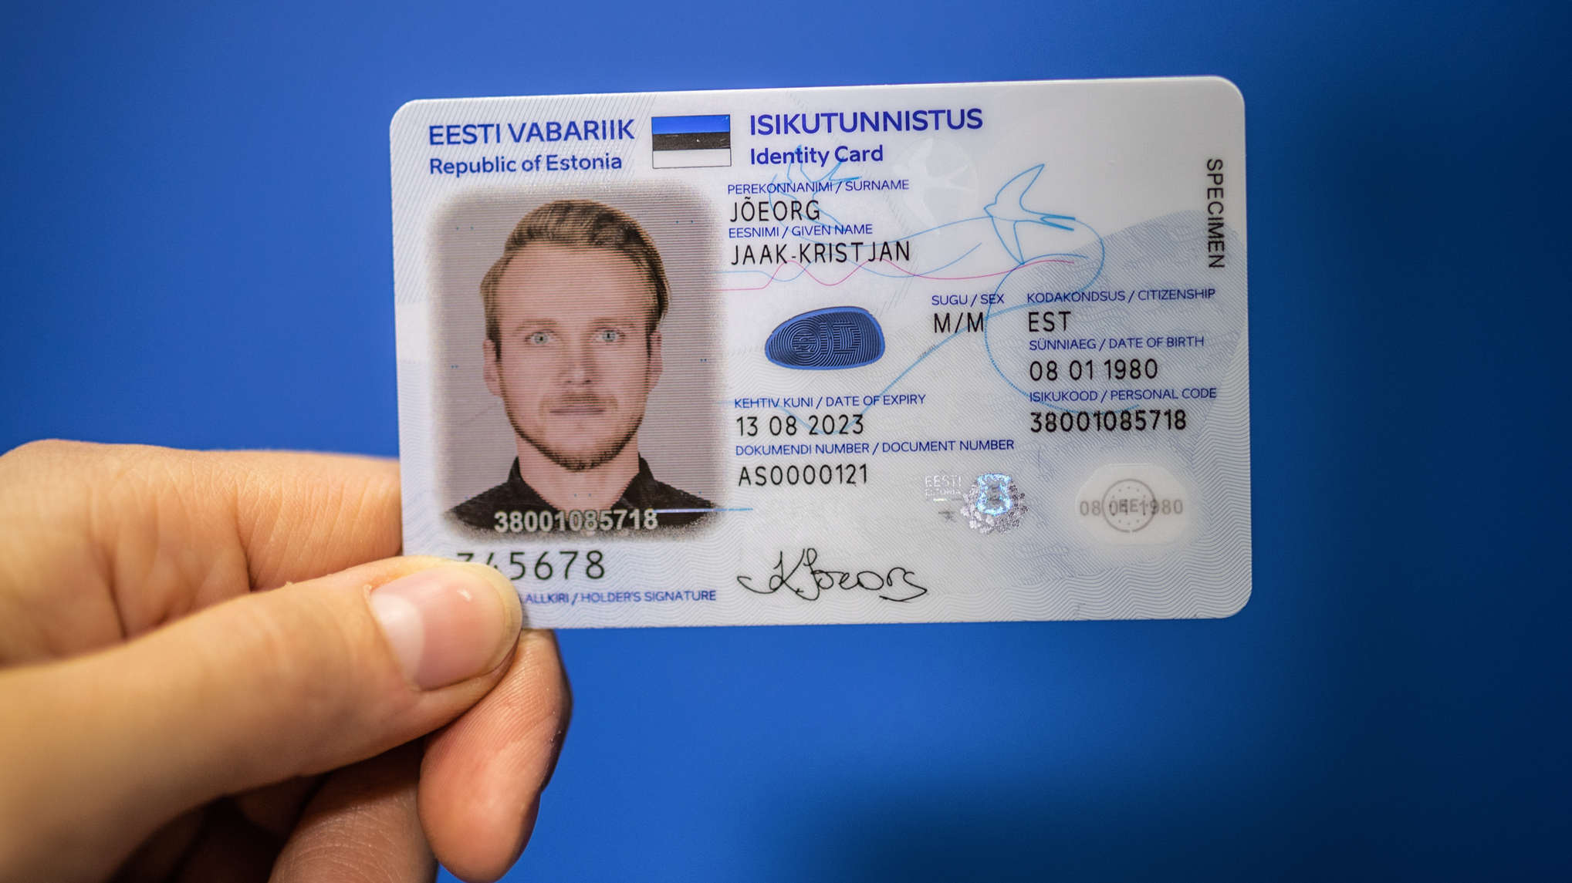


Public Key Infrastructure
ID card, residence card, diplomatic IDs, Mobile-ID, Digital ID, e-Residency card

Slide 4


engaged to all life activities
e-prescriptions
enter point to all government’s e-services
driving licence
signing documents
access banking services
loyalty card
travel document

Slide 5



digital business environment
98% of companies established online
99,6% of banking transactions are done online
98% of people declared their income online
92% of population use the internet on a regular basis
#1
#18
#1
ENTREPRENEURIAL ACTIVITY
World Economic Forum 2017
EASE OF DOING BUSINESS
World Bank 2020
INTERNATIONAL TAX COMPETITIVENESS INDEX
Tax Foundation 2020

Slide 6

ease of doing business
simplest and fastest business environment
© EAS
under 3 hours to start a company
paperless and hassle-free e-taxation
Startup nation – supporting ecosystem
e-residency – Estonian e-services for every world citizen

Slide 7




importance of decision-making
research and development
transparency and communication
cyber hygiene
campaigns of awareness
personal identification verification process by PBGB

Slide 8

lessons learned
no more if, but how
© Johannes Arro
digital-minded leadership
keep it short and simple
transparency works
trainings and communication
public-private partnership
EU digital wallet

Slide 9





stronger together
improved life quality, digitally enabled
sign up to our newsletter and follow us:
e-Estonia
e-estonia@eas.ee
ERIKA PIIRMETS
e-Estonia Briefing Centre
erika.piirmets@eas.ee

